Slide 1
Patent 2,3 Based -
Equity Investment Proposal
1. Proposal Overview
The global financial system is transitioning to blockchain technology. Our institution manages key patents to prepare for the commercialization of CBDCs and digital financial innovation. Accordingly, we propose a business partnership utilizing the following key patents to institutions interested in participating in this initiative.

Slide 2
2. Introduction of Patents for Business Proposal
• IP Asset Management: GBFC IP Asset Management Division
• Target Patents: Integrated System based on Patent 2 + Patent 3
o Patent 2: Intermediary system for transactions of goods and cryptocurrencies (Registration No. 10-205****)
o Patent 3: System for evaluating goods and supporting cryptocurrency transactions (Registration No. 10-19***** / International Application: PCT/KR2018/008***)
• Patent Registered Country: Republic of Korea (Patent Holders: Sion et al. / Priority Claim Date: July 13, 2018 / Validity Period: Until July 13, 2038)
• Application Fields: Financial platforms, digital authentication, P2P investment mediation
• Technology Summary: Core technology based on smart contracts that enhances efficiency in the trading of physical assets and cryptocurrencies through blockchain and P2P mediation

Slide 3
3. Target Partners and Timeline
Immediate Implementation
Financial platform operators in Korea (e.g., Ban****, Na****, NH* Pa***)
P2P lending platforms and fintech startups (e.g., Peo****, Bank****, Fi****, F****)
Strategic partnerships required with prior users and circumvention companies (e.g., Ka***, T****)
Strategic Implementation
Integration with global blockchain financial standardization
Expansion of global digital authentication platforms
Establishment of Web3-based community finance platforms

Slide 4
4. Market Valuation &
(1) Current Value: Approx. (??? billion USD) (Reflecting the potential utilization of fintech and P2P platforms)
Korean Royalty Revenue
Annual Royalty Revenue
Approx. (?? billion USD) (Royalty rate: 2-3%)
Approx. (? billion USD)
Retroactive Revenue (5 years)
Global Corporate Royalty Revenue
Approx. (? billion USD)
Approx. (?? billion USD) (Royalty rate: 2%)
Total Expected Royalty Revenue: Approx. (?? billion USD)
Global Expansion Potential: Over (??? billion USD) (when applied to international financial transaction authentication and investment mediation platforms)
Total Valuation: Approx. (???? billion USD) (Reflecting strategic scalability, potential changes due to policy and regulations)

Slide 5
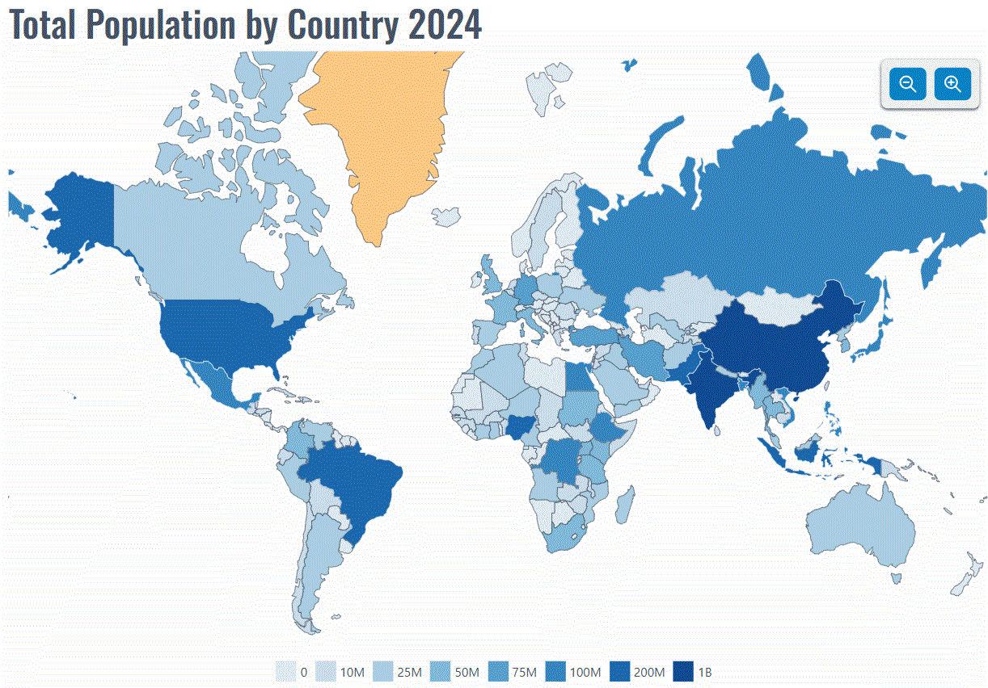
Equity Investment Proposal
(2) Primary Investment (Minimum: ?? million USD)
Equity Offered: 10%
Related Korean Royalty Revenue: Approx. ??? million USD
(3) Secondary Investment (Minimum: ??billion USD)
Investment Recovery Period: Minimum 6 years (Assuming IRR ??%)
Investment Type: Equity Investment + Joint Utilization Agreement + Optional National Exclusive License
First Payout: 1.5 times the investment amount (Approx. ?? million USD) when royalty revenue exceeds ??? million USD
Conservative Equity Value( ??billion USD) (Investment: ? billion USD) - IRR 11.3%)
Second Payout: Up to (??? million USD) when global royalty expansion revenue exceeds ???? million USD
Expansive Equity Value: Up to (??? billion USD) (Investment: ??? billion USD) - Adjusted for growth potential)

Slide 6
5. Proposal Purpose and Utilization Plan
Purpose
Fund Usage
Standardization and expansion of digital financial authentication platforms
Development of a global P2P investment platform based on API-driven SaaS solutions
Research and policy development for legislative adaptation
Establishment of a global P2P financial network
Joint patent applications and localization of rights in key global markets (Japan, Indonesia, USA, Europe, Southeast Asia)
Securing technology to respond to international financial regulations
Promotion of commercialization and partnerships with global digital financial institutions
Building a global platform model for the protection of survival rights
Potential for joint royalty business or additional investment linkage with co-owned patents

Slide 7
6. Future Expansion Potential
Upon CBDC Institutionalization: National Exclusive Collaboration
Web3 & STO Markets
Market potential exceeding (???? billion USD)
Digital Finance & Microloans
Billions to trillions KRW per country
Secured Financial Markets
Potential to absorb hundreds of ??? billion USD
DAO and Decentralized Finance Integration: Unlimited scalability targeting global DAO financial communities
International Protection Expansion Plan: Targeting entry into over 50 countries by the end of 2025, reflecting the quantified global protection and value increase upon completion of rights registration.
Note: The valuation reflects the expected commercialization and legislative adaptations projected for 2025-2026.

Slide 8
Legal Notice and Contact Information
Legal Notice
Contact Information
This proposal will be null and void if no response is received within 15 days, and the validity period is 30 days.
Institution: GBFC (Global Blockchain Finance Committee) IP Asset Management Division
If a response is given, a reply document (including contract conditions and desired options) must be submitted to our institution.
Website: https://gbfc.center
This proposal must not be disclosed, shared, or leaked to third parties without the explicit written consent of the institution.
Agency: Mobi***** Co., Ltd.
Seoul Contact Office: Director of Strategy, Sion
This document contains trade secrets, and unauthorized disclosure will result in legal liability.
Email: ipteam@gbfc.center
For offline meeting requests prior to contract signing, a donation for preparation is required.
Proposal Date: May. , 2025

